Slide 1

Sentiment Analysis
Text Analysis
Looking Beyond NPS with Sentiment Analysis
IOD Capstone Project
Kelvin Liew
4th June 2022
Notes:
Good afternoon, ladies, gentlemen, and Mahesh; thank you for your time on my Capstone project, “looking beyond NPS with Sentiment Analysis”. The mapping of customer journeys for a better user experience. We look at the NPS figures, and there is room for improvement. But where to start?
Things change. We can no longer hide behind NPS on the technical performance of our services. Out in the real world, it’s all about customer satisfaction, and reaching all the SLAs doesn’t cut it anymore. It’s about enabling the workforce to do their work well and providing a good customer experience. But how do we measure experience? How do we translate results to insights, in insights to improvements?
McKinsey found that organizations that offer good services from start to finish have higher customer satisfaction, lower customer churn rate and happier customers—and providing good services all-round works better than trying to exceed customers’ expectations. With a customer journey, we put ourselves in our customer’s shoes and look at the services through their eyes. Map all interactions the customer uses to reach his goal – his problem being solved quickly and smoothly. This way, we discover which elements in the customer journey need some attention. Once we know, we can improve on those elements.
This Capstone project used qualitative and quantitative research; understanding can significantly impact how we analyze the success of our technical support services and organization performance.

Slide 2

Agenda
Business Problem & Winning on Purpose
Business Key Points on the Looking Beyond NPS with Sentiment Analysis
Data Collection
Metrics Analysis – NPS, CSAT & CES
Sentiment and Emotion Analysis
Thematic Analysis
Conclusion and Recommendations
Looking Beyond NPS with Sentiment Analysis
Notes:
This outlines the step-by-step process of the Capstone project, “looking beyond NPS with sentiment analysis”.
We have spent significant time understanding the business problem and the purpose of enriching the lives of our customers.
The business key points are the objective of this project.
And then proceed on data collection, metrics analysis, sentiment analysis, emotion analysis and thematic analysis.
Followed by a conclusion and recommendation of the next steps.

Slide 3

Business Problem
NPS (Net Promoter Score) is now the most widely used Customer Experience metric
1
Simple for customers
2
“Recommend?” is tougher than “Satisfied?”
3
Measures loyalty but not service quality
4
It doesn’t tell you what is important to customers
5
It represents only one dimension of customer loyalty
6
Notes:
Fred Reichheld created Net Promoter Score or NPS in 2003, one of Bain & Company’s Loyalty practices founders. For almost two decades, NPS is becoming the de-facto for organizations to measure customer loyalty and satisfaction.
It is simple to understand and easy to conduct. NPS surveys are straightforward and quick to answer, so they have high response rates (on average of 33%). A low response rate can give rise to sampling bias if the nonresponse is unequal among the participants.
When customers feel loved, feel cared for, and trust their supplier to act in their best interest, that creates the kind of community that customers want to be part of and will work hard to stay a part of because they feel it so strongly that they want that experience for their friend. That is why “Recommend” is tougher than “Satisfied”.
NPS is calculated from a single loyalty question. “How likely are you to recommend us to your friends?”. Based on the rating of this question using from 0 (Not at all likely) to 10 (Extremely likely) scale, customers are segmented into three groups:
Detractor (ratings of 0-6),
Passives (ratings of 7-8) and
Promoter (rating of 9-10)
NPS measure loyalty by identifying who are promoters, passives, and detractors but not service quality.
It doesn’t tell us what is important to customers. For every complaint we receive, there are approximately 26 customers who are unhappy with the company but choose to say nothing. Those are the customers we will most likely lose if we don’t take proper action.
Customer experience is the way customers perceive how the company interacts and treats them. That perception has the potential to influence the way people feel about the business, and how likely they are to do business with us and talk positively about the company. Hence multidimensional metrics could be used to approach the customer and analyze the result – data that if acted upon leads to increased customer loyalty, retention and sustainable business growth.

Slide 4

Winning on Purpose
A systematic approach to fostering customer loyalty, a deeper understanding of customer satisfaction and customer effort to obtain services can accelerate profitable, sustainable organic growth.
Keep customer satisfied
Engage closely, influence actively:
Loyalty is multidimensional; it is not a single thing.
Combination of NPS, CSAT & CES for analysis
High
Better insight into customer experience, situation, & pain points.
Connect customer sentiment, emotion & behavioural in the analysis.
Monitor (minimal effort):
Uncover areas for improvement across Sales, Support, Customer Success, Marketing, Engineering, and Product.
Keep informed
Pulse check over time
Find the root cause with follow up question
Dashboard for multiple topics and combine with NPS
Low
High
Notes:
With the philosophy of “Our primary purpose is to enrich the lives of our customers” we need to have feedback mechanisms that help us know when we are doing it well, when we are not, and what needs to change.
On the other hand, giving employees the ability to not just listen to what our customers are saying but to capture that voice, to get together in huddles (daily and weekly) to talk about that, to then push that up the chain of command so we almost have a representative democracy when the front-line employees are listening to the customers and communicating upwards to senior executives what needs to change.
The most important is the multidimensional metrics introduced, i.e., NPS, CSAT, CES, sentiment, emotion and thematic analysis, to give better insight into customer experience, situation and pain points to uncover areas of improvements that matter to our customers.

Slide 5
Business Key Points
Looking Beyond NPS with Sentiment Analysis
Sentiment analysis provides a more precise level by breaking it down into positive, negative and neutral experience.
NPS (Net Promoter Score)
CSAT (Customer Satisfaction)
Emotion detection identifies specific emotions that include happiness, frustration, shock, anger and sadness.
CES (Customer Effort Score)
Sentiment Analysis
Emotion Detection
Combine behavioural data with learnings from the silent majority and the vocal minority customers who give feedback on whether they are loyal or not.
Thematic Analysis
Notes:
What the business need is like the Iceberg theory. The iceberg principle is a theory that suggests we cannot see or detect most of a situation’s data. As with an iceberg, only its tip is visible, while its bulk is below the water’s surface, i.e., invisible.
NPS is primarily a relationship metric and measures loyalty, therefore an indicator of future business growth due to its correlation to customer loyalty. It is the tip of the iceberg.
CSAT is highly effective for tracking how your customer feels through the entire customer lifecycle. If satisfaction drops at any touchpoint, you will have the insights necessary to follow up with the customer and close the feedback loop.
CES explores how much effort a customer feels they had to put in to resolve an issue and is usually used to help customer service improve resolution times and provide higher-quality experiences.
Sentiment analysis provides a more precise level by breaking it down into positive, negative and neutral experiences.
Emotion detection identifies specific emotions: happiness, frustration, shock, anger, and sadness.
Combine behavioural data with learnings from the silent majority and the vocal minority customers who give feedback on whether they are loyal or not.
NPS, CSAT, and CES, are used worldwide to enable companies to have the stakeholders’ attention to improve the Customer Experience and, ultimately, their bottom line. Nevertheless, combined with a large amount of data available from the CRM, these customer service metrics become even more powerful.
That’s why we are building a strategy around tracking and, as a result, improving on the top three customer service metrics: CSAT, NPS®, and CES with sentiment analysis.

Slide 6

Data Collection
6 Steps in Collecting Data
Survey Questions
Outcomes
Determine Our Objectives
Select Respondents
Create A Data Analysis Plan
Develop The Survey
Pre-test The Survey
Distribute and Conduct the Survey
How likely would you recommend our Services to a friend or colleague? (Scale 0 to 10)
What are the primary reasons for the score you gave us? (Open-Ended)
Would you agree that our service is convenient to access? (Scale 1-5)
How would you rate your experience with our service desk? (Scale 1-5)
How would you rate our service desk follow up and communication skills? (Scale 1-5)
How would you rate the proactiveness of our engineers? (Scale 1-5)
How would you rate the competency of our engineers to resolve your issue? (Scale 1-5)
How would you rate the friendliness of our engineers? (Scale 1-5)
How can we make your experience better? (Open-Ended)
Invitations
439 opened (62%)
711
Total
Invitations
240 unopened (33%)
32 bounced (5%)
SurveyMonkey is a cloud-based survey tool that helps users create, send and analyze surveys.
285 clicked through (40%)
2 opted out (0.3%)
Responses
The dataset used in this analysis is a set of questionnaires answered by customers about the services.
The survey was sent using SurveyMonkey and downloaded as CSV files. We will be using is called “Customer Experience – {SERVICE}.csv” where {SERVICE} could be one of the following services: APS, AMS, Clouds, EUC and DaaS.
130 completed (100%)
130
Total
Responses
0 partial (0%)
18% Response Rate
Notes:
The data collection process focuses on the online survey as a method. Hence, the first thing is to identify a survey tool that helps create, send, and collect survey data. Many tools are available in the market, and prices range from free to appropriately $1000/- per annual, per user. Due to budget constraints, we selected SurveyMonkey as our cloud-based survey tool. It is a cost-effective solution, but we received feedback from the customer that it looks like a SPAM email.
There are 6 steps in collecting the survey data, and we are interested in understanding what our customers think and do. By now, we have determined our objectives (i.e., Business Key Points as the business requirements), population, sampling strategy, survey method, and analysis plan.
Survey questions can be asked in an open-ended and closed-ended format. Open-ended questions allow users to input their own answers and do not provide predefined response options.
Closed-ended questions provide different types of response options from which respondents can choose an option. In contrast to open-ended questions, closed-ended questions are easy to answer and allow us to conduct statistical analysis of the results.
Pre-testing: Just because we’ve written our survey questions doesn’t mean the survey is ready to go! The next step is to test and ensure that we’ll get quality responses. It can reveal numerous problems, such as poorly phrased questions, missing response categories, etc.
We send out the survey via email and send reminders after a week.
The survey outcome after three weeks is as follows:
The total survey invitations sent are 711.
The response rate is 18% i.e., 130/711. The industrial response rate in the 2021 benchmark is 30%.
The low response rate could be one of the following reasons:
Too many questions as we want to collect NPS, CSAT, CES and 2 Open-ended questions. Almost no one wants to take a lengthy survey with numerous questions. Even though the typical time spent on the survey is appropriately 2 minutes.
Typical NPS surveys, focusing on THE big question is key. We can honestly tell our users that they can get in and out of the survey in under 30 seconds, making them more likely to respond. We can offer an open-ended follow-up question to collect more feedback.
Uninterested sample group: Beyond statistical inaccuracy, low response rates indicate that the potential respondents are not interested in taking part in our survey.

Slide 7
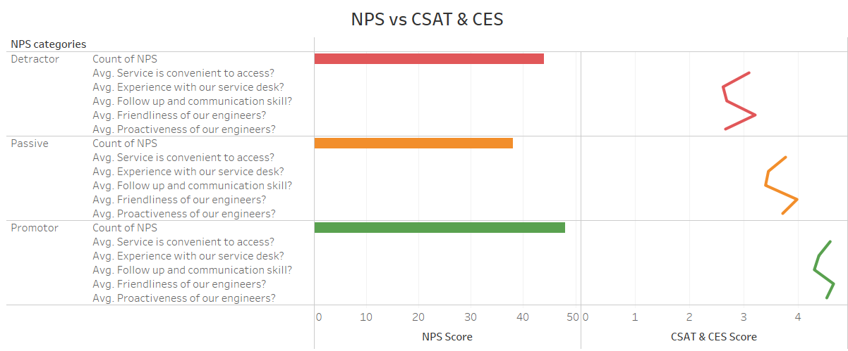
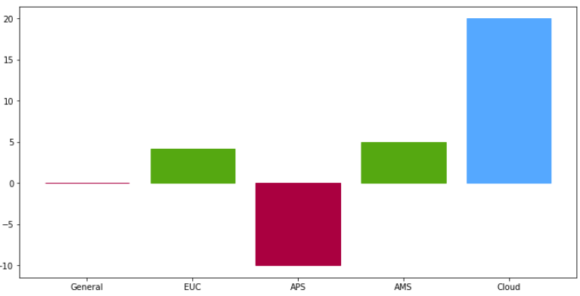
Metrics Analysis
Customer Satisfaction Score
Net Promoter Score
Customer Effort Score
-100
0.03
100
0
73.5%
100
0
76.7%
100
Category | Counts | Percentage
Promoters | 48 | 36.9%
Passives | 38 | 29.2%
Detractors | 44 | 33.9%
Total | 130 | 100.0%
Category | Counts | Percentage
Delights | 160 | 24.6%
Satisfies | 202 | 31.1%
Almost Satisfies | 217 | 33.4%
Disappoints | 71 | 10.9%
Total | 650 | 100.0%
Category | Counts | Percentage
Delights | 33 | 25.4%
Satisfies | 46 | 35.4%
Almost Satisfies | 48 | 36.9%
Disappoints | 3 | 2.3%
Total | 130 | 100.0%
NPS by Target Groups
Notes:
We will discuss the three customer satisfaction matrics: NPS, CSAT and CES.
to recap, NPS measures the long-term relationship. CSAT directly measures customer satisfaction levels, and CES measures customer satisfaction levels by focusing on the efforts customers make to interact with our technical support services.
Firstly, let’s look at the low right corner of the slide. NPS vs CSAT and CES.
This analysis shows that detractors give an average CSAT and CES score of 3. Passives give an average CSAT and CES score of 4, and Promoters give an average CSAT and CES score of 5. This result shows that CSAT and CES scores should obtain at least 80-85% before the NPS score could be improved.
The left-hand corner of the slide shows the NPS by target groups. The APS groups failed badly, with a negative NPS score of -10.
If you can remember, the NPS score can range from -100 to +100 range; any score above zero reads as 'good' because it indicates that a business has more promoters than detractors. It is natural as we are slightly above 0 by 0.03 (i.e., four promoters more than detractors). Because our nonresponse rate is high (i.e., 82%), the analysis can give rise to sampling bias if the nonresponse is unequal among the participants regarding the outcome.
We will move on to sentiment and emotion analysis.

Slide 8
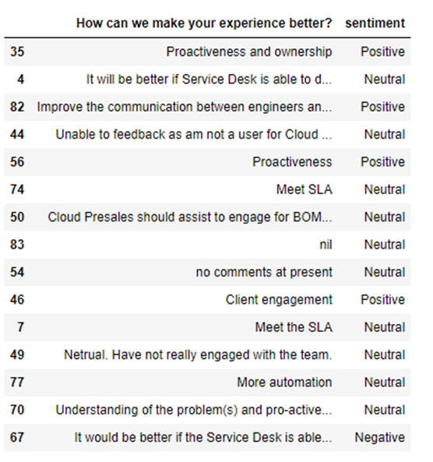
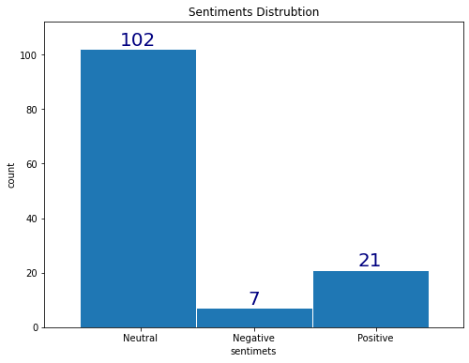
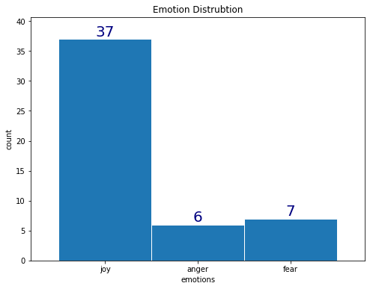
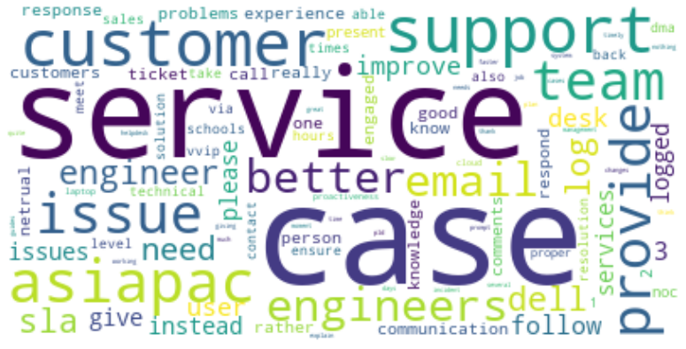
Sentiment and Emotion Analysis
16% positive sentiment distribution
26% negative emotion distribution
Customer churn is predicted if no improvement is made.
BAD
SO SO
GOOD
Notes:
Sentiment analysis (or opinion mining) is an NLP technique used to determine whether data is positive, negative, or neutral.
There are two open-ended questions in the survey that provide the textual data for sentiment and emotion analysis. They are as follows;
What are the primary reasons for the score you gave us?
How can we make your experience better?
Sentiment analysis is performed on textual data of these two questions in customer feedback. Emotion detection sentiment analysis allows going beyond polarity to detect emotions like happiness, frustration, anger, and sadness.
The result of the overall sentiment of positive distribution is 16%, and the negative emotion distribution is 26%. On comparing the NPS score of 0.03. CSAT of 73.5% and CES of 76.7% ,which is below 80% marks. Hence, the conclusion is customer churn is predicted if no improvement is made.
This method offers further insights into the voice of customer (VoC).
Tracking customer sentiment over time adds depth to help understand why NPS, CAST, CES and feeling toward individual aspects of our business may have changed.

Slide 9
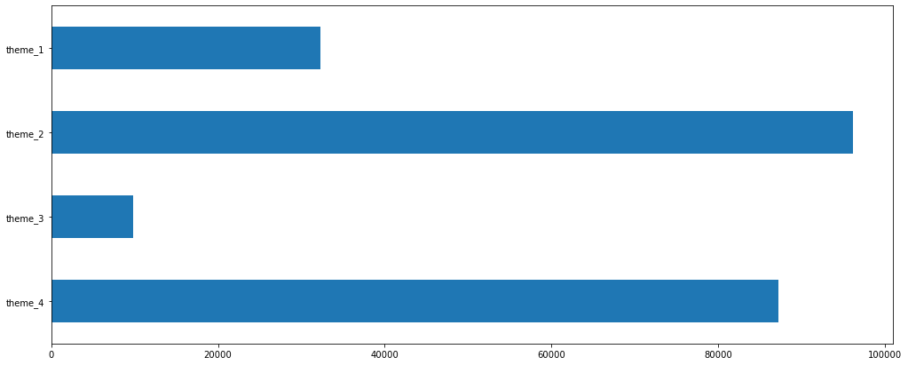
Thematic Analysis – Exploratory Data Analysis
Text Preprocessing
Transform Text Features to Numeric
Build LDA Model
Plot the WordCloud
CRM Raw Text
Build Trigrams
The data used is extracted from CRM on Incident, Service Request and detailed work logs.
This step is an aggregation of the 3 CSV files containing different fields, but our sole interest is the text expressed by the customer.
This aggregation gives a dataset of 225,409 raw records to be the process
The features included in this preprocessing stage are :
Lowercase text
Remove non-words, e.g. IDs, references, etc.,
Remove punctuation
Remove numbers
Remove special characters
Remove emails
Remove stop words
Remove NAN
Tokenize
Lemmatize
Create dictionary and corpus, themes in the LDA model
Faster way to get a sentence clubbed as a trigram/bigram
spacy for lemmatization
Do lemmatization keeping only noun, adj, verb, adv
Create dictionary id2word
Create Corpus
Term document frequency
Find the optimal number of themes i.e., 3
Train LDA algorithm
Assigns the topics to the documents in the corpus
Plot the WordCloud for each theme

Slide 10
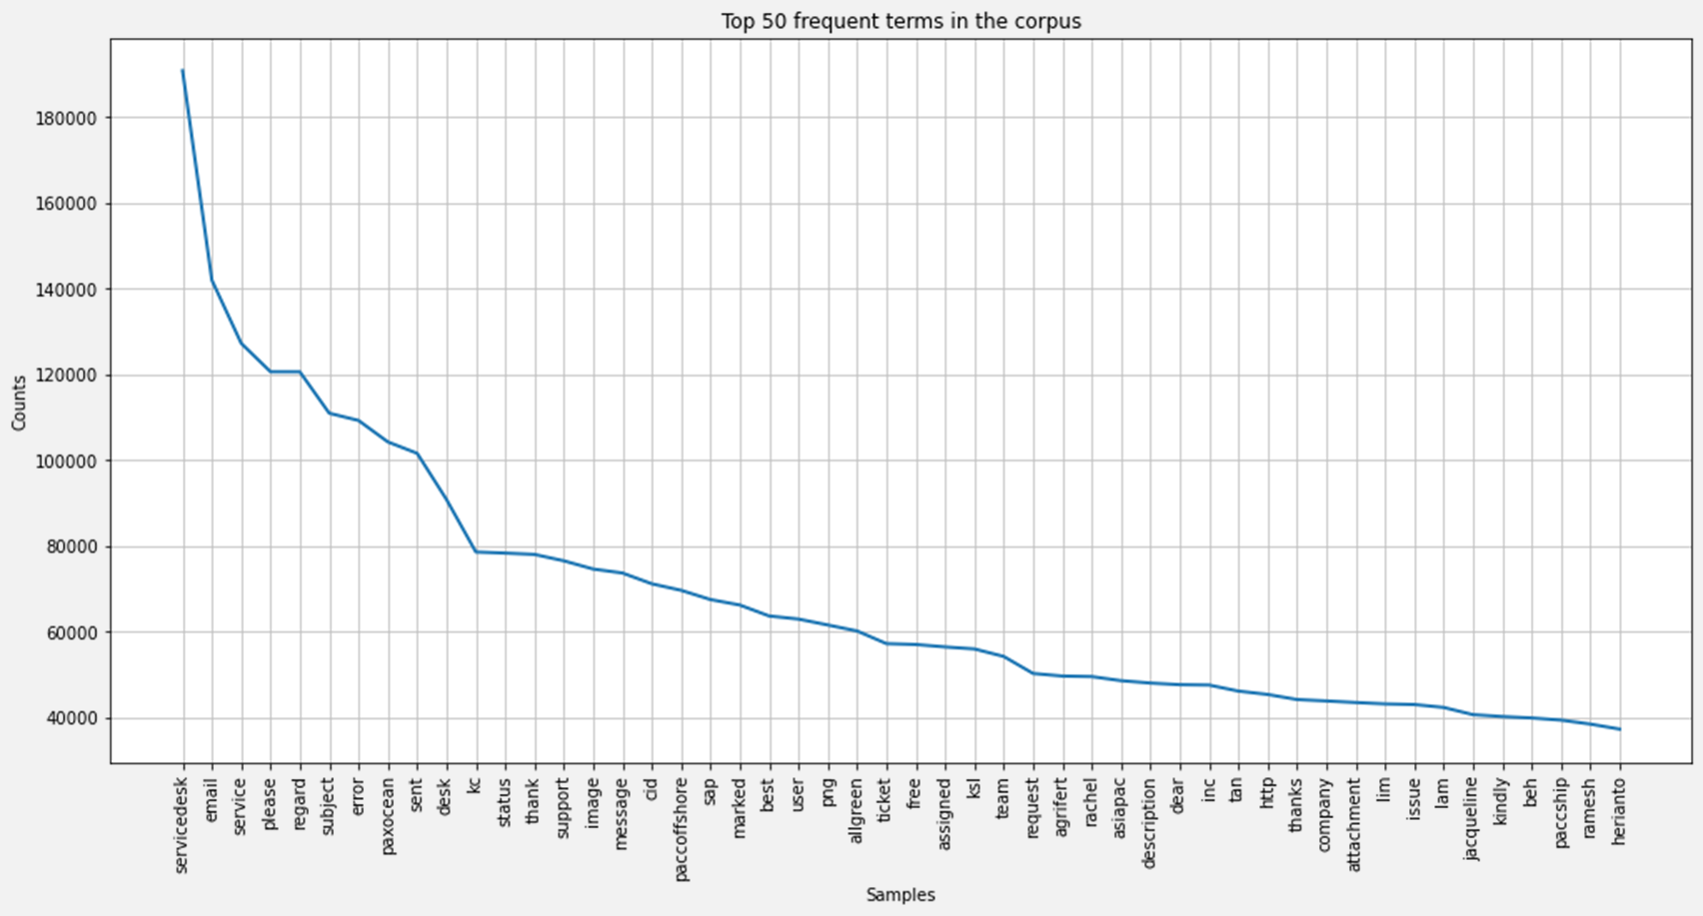
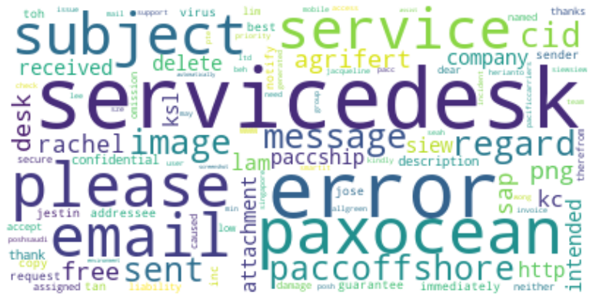
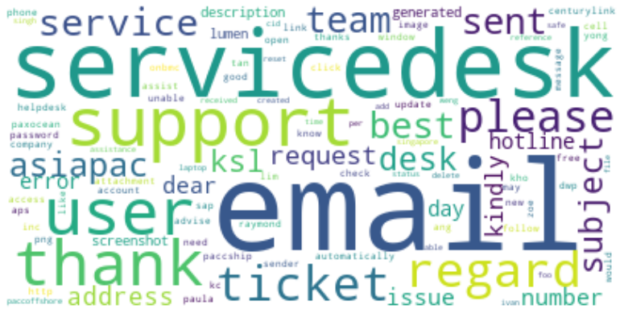
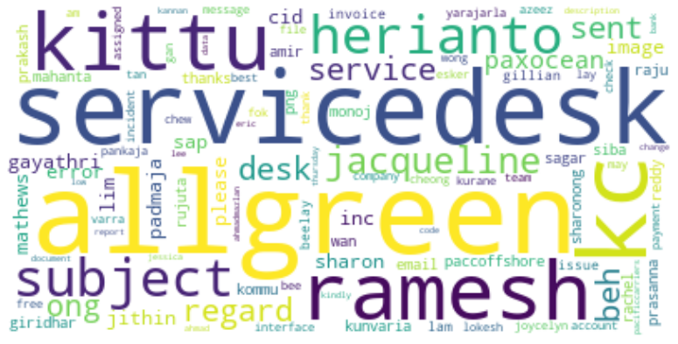
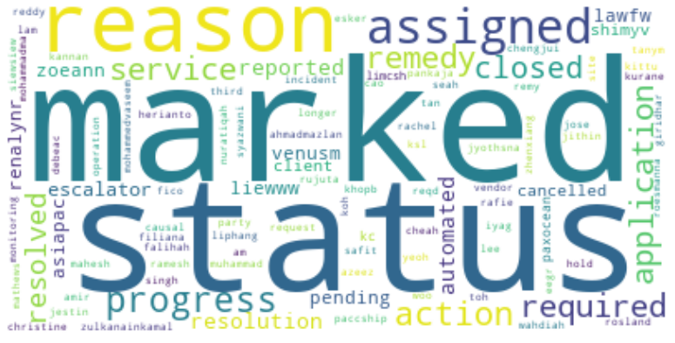
Thematic Analysis
Top 50 Frequent Words
Theme 1
Theme 2
The thematic wordings reflect some challenges for APS, EUC and DaaS service groups
Theme 3
Theme 4
Service Desk skills in resolving first call resolution
Service Desk and Engineer follow up on the cases or requests

Slide 11
Conclusion
This Capstone project used qualitative and quantitative research; understanding can significantly impact how we analyze the success of our technical support services and organization performance
Put pressure on the company in question
Have created the challenge you’re solving
Wining on Purpose
A deeper understanding of the customer journey could be achieved with multidimensional matrices and sentiment analysis. I.e, NPS, CSAT, CES, Sentiment and Emotion Analysis including Thematic Analysis.
Thematic Analysis could provide more insight into customer experience, situation and pain points
A dashboard could be built to provide pulse checks over time and find the root cause with follow up question
Notes:
This Capstone data analysis project works from a simple calculation of different matrices i.e., NPS, CSAT and CES to very complex machine learning algorithms like sentiment analysis, emotion analysis and thematic analysis.
The lifecycle of customer engagement at every touch point, help us to understand how our customer feels with a customer journey mapping through all interactions the customer uses to reach his goal – his problem being solved quickly and smoothly. This way, we discover which elements in the customer journey need some attention. Once we know, we can improve on those elements.

Slide 12


What’s Next?
The company is setup to meet the challenge and where they’re not.
Try another representation of our features
Hyper-parameters tuning for LDA (Linear Discriminant Analysis) model
Try different other clustering algorithms

Slide 13

THANK YOU!

